Slide 1

Spring Data
[By Bao Huynh]

Slide 2

A. Table Content
Spring Data
1.1 Kick-off with JDBC
1.2 Overview Spring Data
Spring Data JPA
2.1 Overview Spring Data JPA Flow
2.2 Behind the screen (Java Persistence API)
Spring Repository
3.1 Concept
3.2 CRUDRepository
3.3 PagingAndSortingRepository
3.4 JPARepository
Demo Code
Spring DataJPATest

Slide 3
1. Spring Data
1.1 Kick-Off with JDBC
Java Application
DB
JDBC
1.1.1 Java Database Connectivity

Slide 4
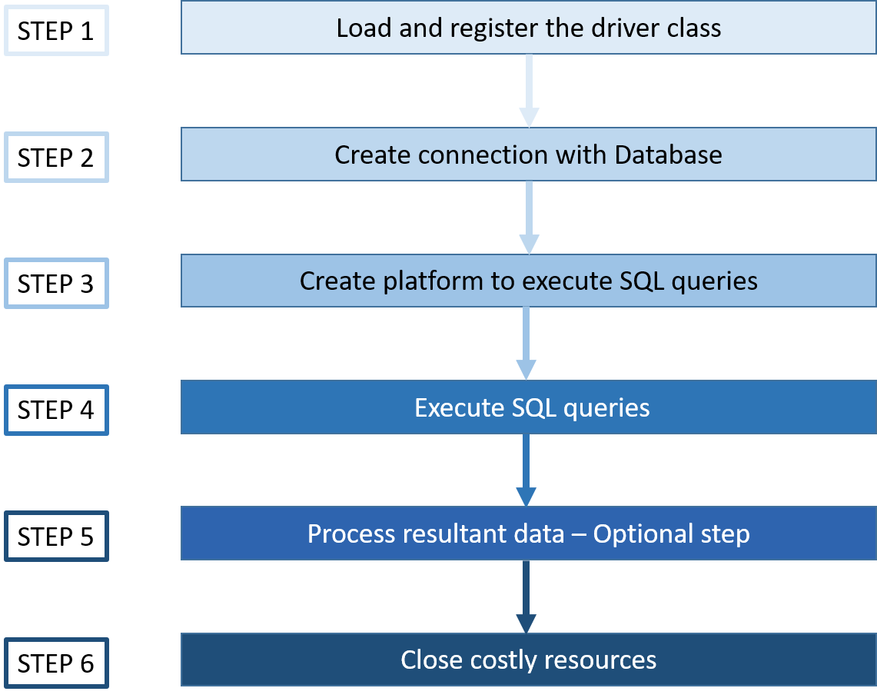
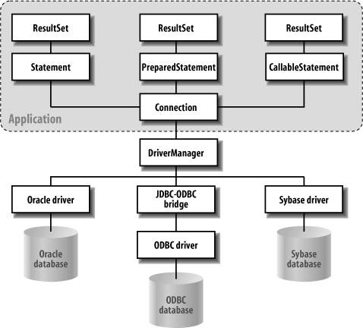
1. Spring Data JPA
1.1 Kick-Off with JDBC
1.1.2 JDBC connection steps in java
1.1.2 JDBC Architecture

Slide 5
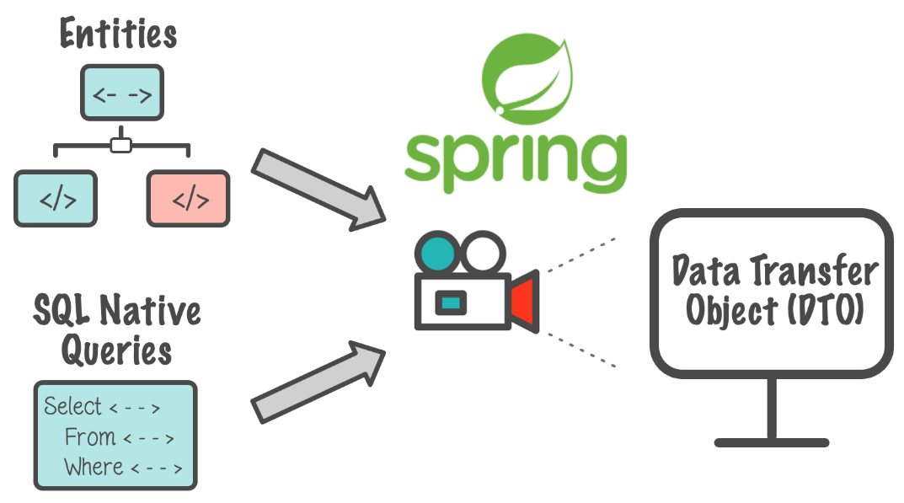
1. Spring Data JPA
1.2 Overview Spring Data
Purpose: It make easy to use data access technologies, relational and non-relational databases, map-reduce frameworks, and cloud-based data services.
Mission: to provide a familiar and consistent, Spring-based programming model for data access while still retaining the special traits of the underlying data store.
1.2.1 Spring Data mission

Slide 6
1. Spring Data JPA
Service
(1)
Entity
Repository
Data type: Parameters
1.3 Behind the Screen
(2)
Proxy
Entity
DB
Data type: Parameters
Custom
RepositoryImpl
<Spring Data>
SimpleJpa
Repository
(3)
Entity
JPA APIs
Data type: Parameters
Hibernate
JPA reference
implementation
SQL
Entity
Bind values
(4)
Data type: Parameters
JDBC Driver
JDBC Basic APIs
SQL
Hibernate Core APIs
(5)
Bind values

Slide 7
1. Spring Data JPA
Service
Entity
(Entity)
(Repository and JPA Repository)
JPARepository
Data type: Parameters
1.3 Behind the Screen
Proxy
Entity
DB
Data type: Parameters
Custom
RepositoryImpl
<Spring Data>
SimpleJpa
Repository
Entity
JPA APIs
Data type: Parameters
(JPA)
Hibernate
JPA reference
implementation
SQL
Entity
Bind values
Data type: Parameters
JDBC Driver
JDBC Basic APIs
SQL
Hibernate Core APIs
(Hibernate)
Bind values

Slide 8
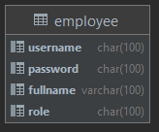
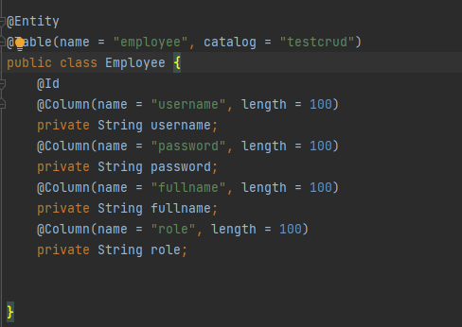
1. Spring Data JPA
1.3 Behind the Screen
Entity: is Object that has some distinct value. In a persistent storage mechanism, an entity is a business object. Each entity has an associated table in relational database. Each instance of the entity represent a row of the table
Table
(Database)
Entity
(POJO)

Slide 9
1. Spring Data JPA
1.3 Behind the Screen
Repository: is a mechanism for encapsulation storage, retrieval, and search behavior, which emulates a collection of objects. (Base on Eric Evans’s book Domain-Driven Design). In other words, a repository also deals with data and hides queries similar to DAO. However, it sit at a higher lever, closer to the business logic of an app.
Action retrieve
SelectAll()
SelectByID()
Insert()
Update()
Delete()
SQL
Action insert
Implement
Action Update
Entities
Action Delete
Repository
Database
User’s Actions

Slide 10
1. Spring Data JPA
1.3 Behind the Screen
JPA: is a specification of java. It is used to persist data between Java object and relational database. JPA acts as a bridge between object-oriented domain model and relational database systems.
As JPA is just a specification, it does not perform any operation by itself. It requires an implementation. Using ORM tools to implements JPA. Frameworks that function on ORM mechanism: Hibernate,…
ORM(Object Relational Mapping)
is a functionality which is used to develop and maintain a relation ship between an object and relational database by mapping an object state to database column. It is capable to handle various database operations easily such as inserting, updating, deleting etc.
Java
(Object)
Database
(Column)

Slide 11
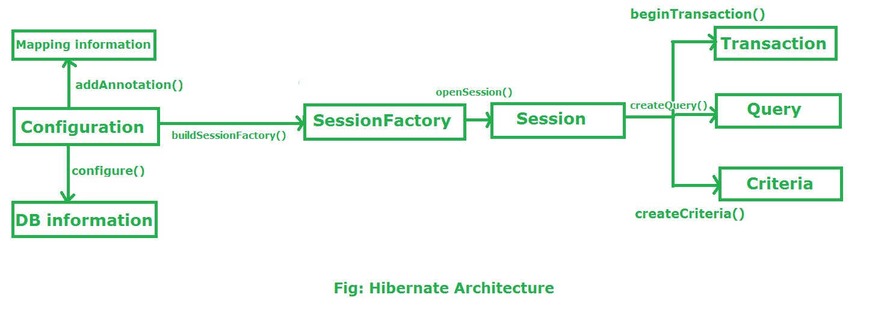
2. Spring Data JPA
2.2 Behind the Screen
Hibernate: is an Object/Relational Mapping (ORM) solution for Java environments. The term Object/Relational Mapping refers to the technique of mapping data between an object model representation to a relational data model representation.

Slide 12
2. Spring Data JPA
2.2 Behind the Screen
Hibernate
Hibernate’s element | Use for
Configuration | Activates Hibernate framework, creates a meta-data in memory and returns the meta-data to object
SessionFactory | Used to create Session Object
Session | It opens the Connection/Session with Database software through Hibernate Framework
Transaction | Used to give the instruction to the database to make the changes that happen because of operation as a permanent by using commit() method
Query | A Query instance is obtained by calling Session.createQuery()
Criteria | The Session is a factory for Criteria

Slide 13
2. Spring Data JPA
2.3 Spring Data Repositories
The central interface in the Spring Data repository abstraction is Repository. It takes the domain class to manage as well as the ID type of the domain class as type arguments. This interface acts primarily as a marker interface to capture the types to work with and to help you to discover interfaces that extend this one.
3 Type Repository in Spring Data:
CrudRepository
PagingAndSortingRepository
JPARepository
(Extends)
(Extends)
CrudRepository
PagingAndSortingRepository
<Interface> JPARepository

Slide 14
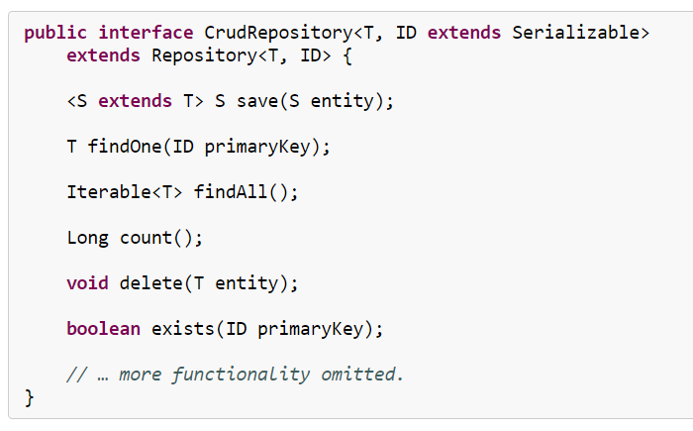
3. Spring Repositories
3.1 CrudRepository
CrudRepository provides sophisticated CRUD functionality for the entity class that is being managed
Save the given entity
Return the entity identified by the given id
Return all entities
Return the number of entities
Deletes the given entity
Indicates whether an entity with the given id exits

Slide 15
3. Spring Repositories
3.2 PagingAndSortingRepository
PagingAndSortingRepository provides method to do pagination and sorting records
3.3 Spring Data JPA
CrudRepository provides some JPA-related methods such as flushing the persistence context add deleting records in a batch.

Slide 16
3. Spring Repositories
<Interface> Repository
<Interface> QrueryByExambleExecutor
Method | Return Value
FindOne(Example<S>) | S
FindAll(Example<S>) | Iterable<S>
FindAll(Example<S>,sort) | Iterable<S>
FindAll(Example<S>,Pageable) | Page<S>
Count(Example<S>) | Long
Exist(Example<S>) | Boolean
<Interface> CrudRepository
Method | Return Value
Save(s) | S
Save(Interable<S>) | Iterable,S>
findOne(ID) | T
Exists(ID) | booleam
findAll() | Iterable<T>
findAll(Iterable<ID>) | Iterable<T>
Count() | Long
Delete(ID) | Void
Delete(T) | Void
Delete(Iterable<? Exteds T> | Void
DeleteAll() | Void
<Interface> JpaRepository
Method | Return Value
findAll() | List<T>
findAll(Sort) | List<T>
findAll(Iterable<ID>) | List<T>
Save(Iterable<S>) | List<S>
flush | Void
saveAndFlush(S) | S
deleteInBatch(Iterable<T>) | Void
deleteInBatch() | Void
getOne(ID) | T
findAll(Example<S>) | List<S>
findAll(Example<S>,Sort> | List<S>
<Interface> PagingAndSortingRepository
Method | Return Value
FindAll(Sort> | Iterable<T>
FindAll(Pageable) | Page<T>

Slide 17
4. Demo Code

Slide 18
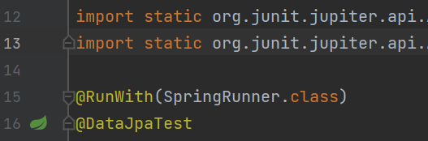
5. Spring DataJPATest
@DataJpaTest is used to test JPA repositories.
It is used in combination with @RunWith(SpringRunner.class).
The annotation disables full auto-configuration and applies only configuration relevant to JPA tests.
By default, tests annotated with @DataJpaTest use an embedded in-memory database.

Slide 19

Thank You!

